Slide 1
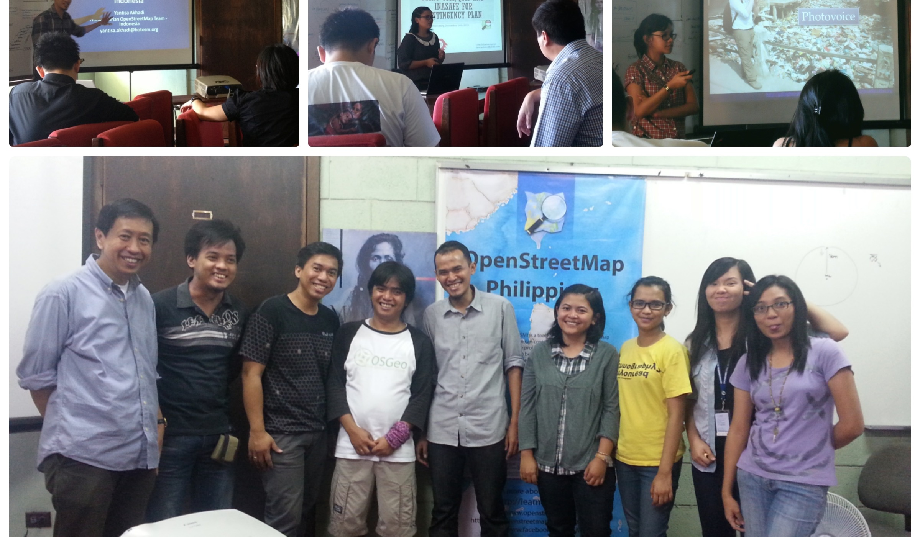
An Introduction to TeachOSM
Teaching Geography with OpenStreetMap

Slide 2
Introductions
What is TeachOSM?
Why do we need TeachOSM?
Highlights
Six Reasons to use OSM to teach geography
Summary

Slide 3
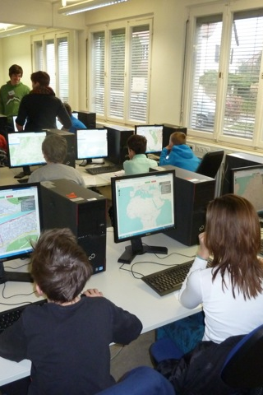
TeachOSM: A Resource for Educators & Education
Using OpenStreetMap to teach geography
Photo: middle-school school students learning to map.
Credit: MaptimeSF/Lyzi Diamond

Slide 4
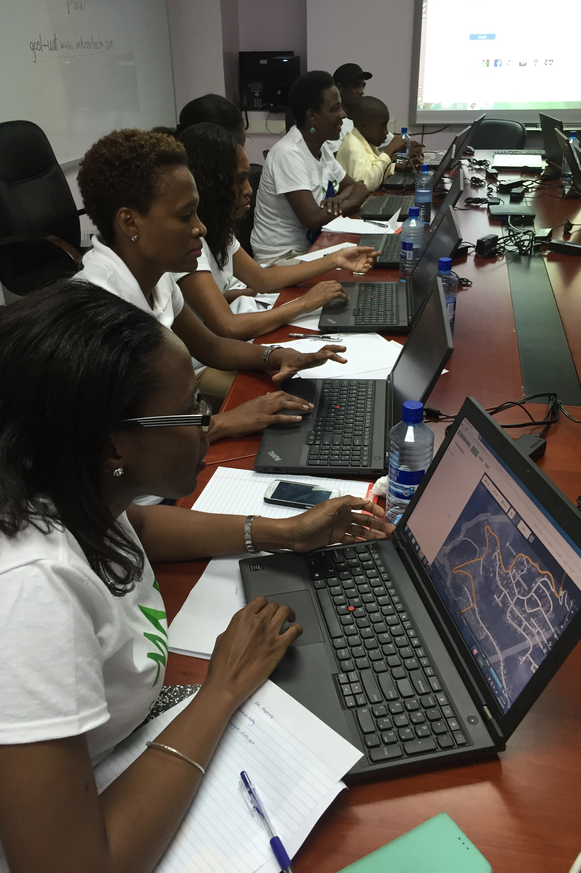
TeachOSM is…
…about using OpenStreetMap to teach geography
…about helping those who use open mapping in the class
…about using OpenStreetMap to develop spatial thinking

Slide 5
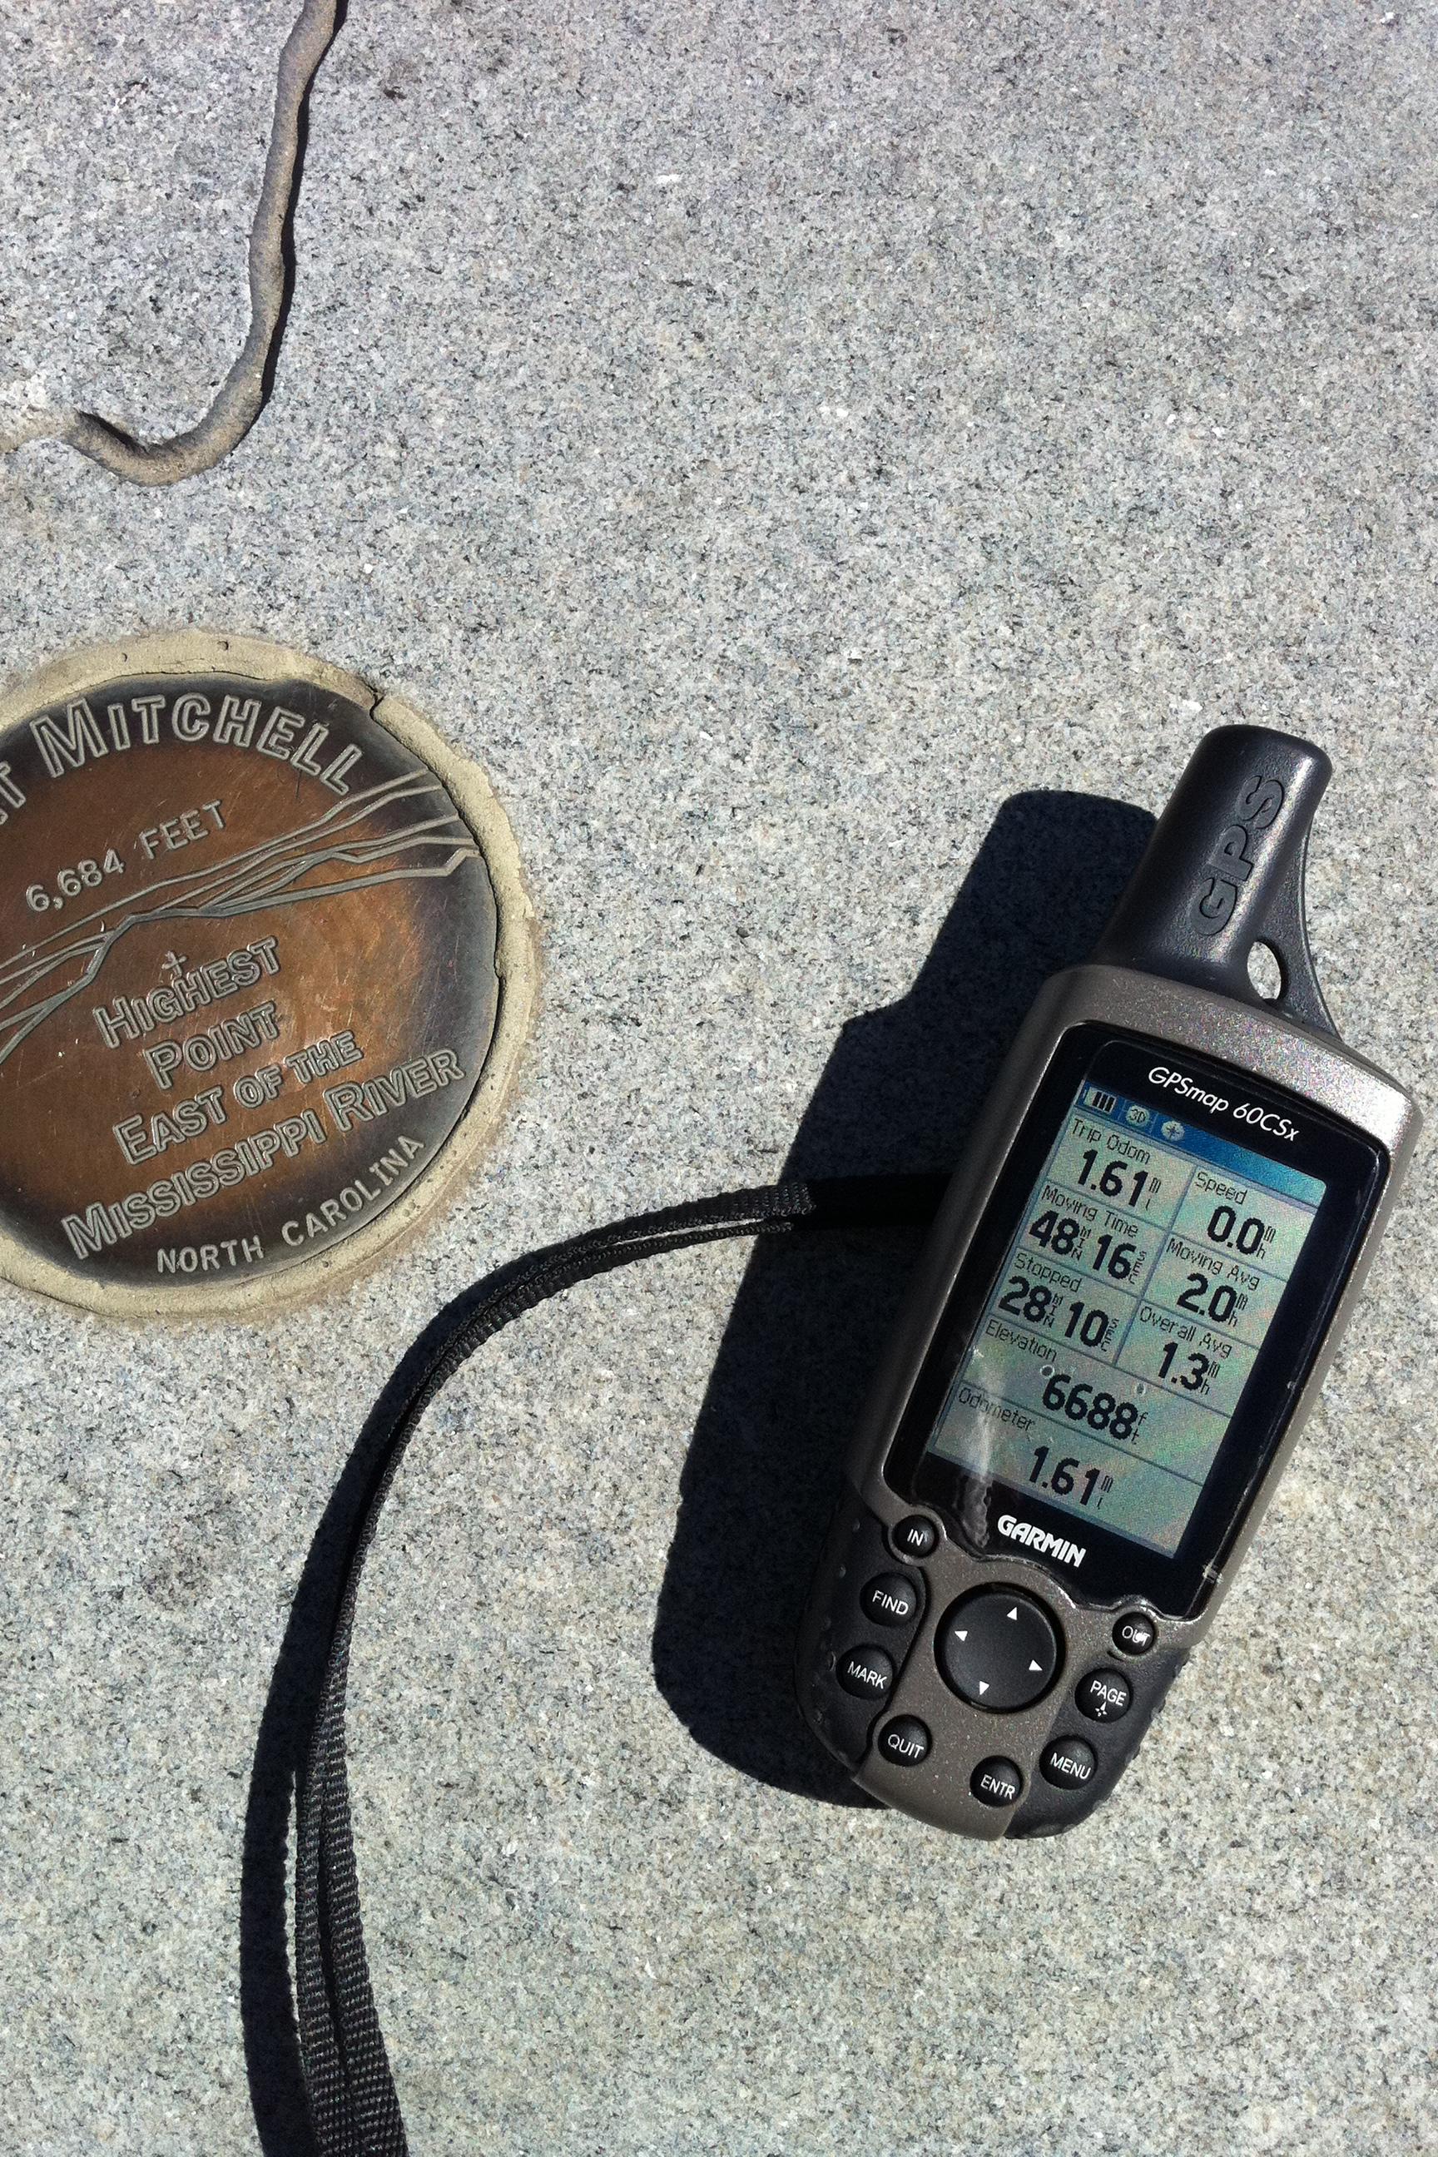
What is TeachOSM?
A growing resource for educators at all levels to introduce open mapping in their classrooms and training sessions.
Modular lessons that convey basic geographic concepts through applied mapping on OpenStreetMap.
Resources to help instructors to identify, assign, manage and grade a mapping assignment.
Photo: Mapping peaks using GPS.
Credit: SEJohnson

Slide 6
TeachOSM is more than just how-to-map
A place for materials geared to the needs of educators and instructors of all types
Classroom
Vocational
Clubs, scouts, social
Tools to engage with and interpret the landscape
Encourage more mappers to sustain the project
Create opportunities for meaningful citizen engagement

Slide 7
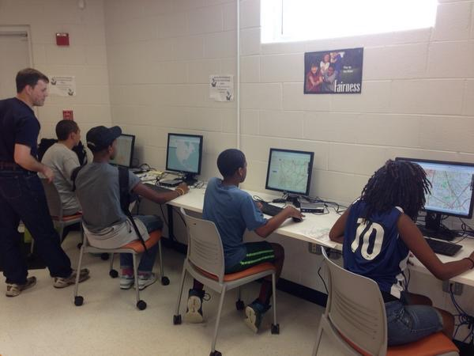
What does TeachOSM do?
Established a web site
Create repository of case studies
Giving half-day workshop for educators
Outreach to teachers, educators, youth leaders
Established micro-credentials to award credit for service hours
Photo: middle-school school students learning to map.
Credit: SEJohnson

Slide 8

For educators…
Basic map editing skills
How to manage student accounts
Organizing & managing your mapping event
The Tasking Manager, for assigning blocks of work
Quality control, assessment, grading
Ready-made projects for teachers to adapt
Photo: Mapathon, Spring 2014.
Credit: Brian DeRocher

Slide 9
For Students…
Teach basic digital mapping skills
Connect with opportunity for vocational learning
Offer service learning opportunities
Humanitarian OpenStreetMap Team (HOT)
MapGive
MissingMaps
DC Great Streets
Cultivate geo-literacy through guided mapping projects
Photo: middle-school school students learning to map.
Credit: SEJohnson

Slide 10


GeoBadges: Micro-credentials for Service Learning
A new initiative to give credentials to students and teachers for contributions to OpenStreetMap
Expectations:
Contribute to the map & foster community
Be a Resource for Peers
Develop an Understanding of Basic Digital Mapping Constructs
Contribute to Community Mapping Goals (local, HOT, MapGive, MissingMaps)
Web: http://geobadges.org/

Slide 11
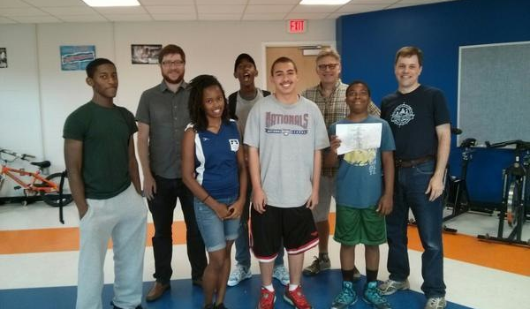
Highlight: TeachOSM and the Georgia Avenue Project
Training Young Adults to Map

Slide 12
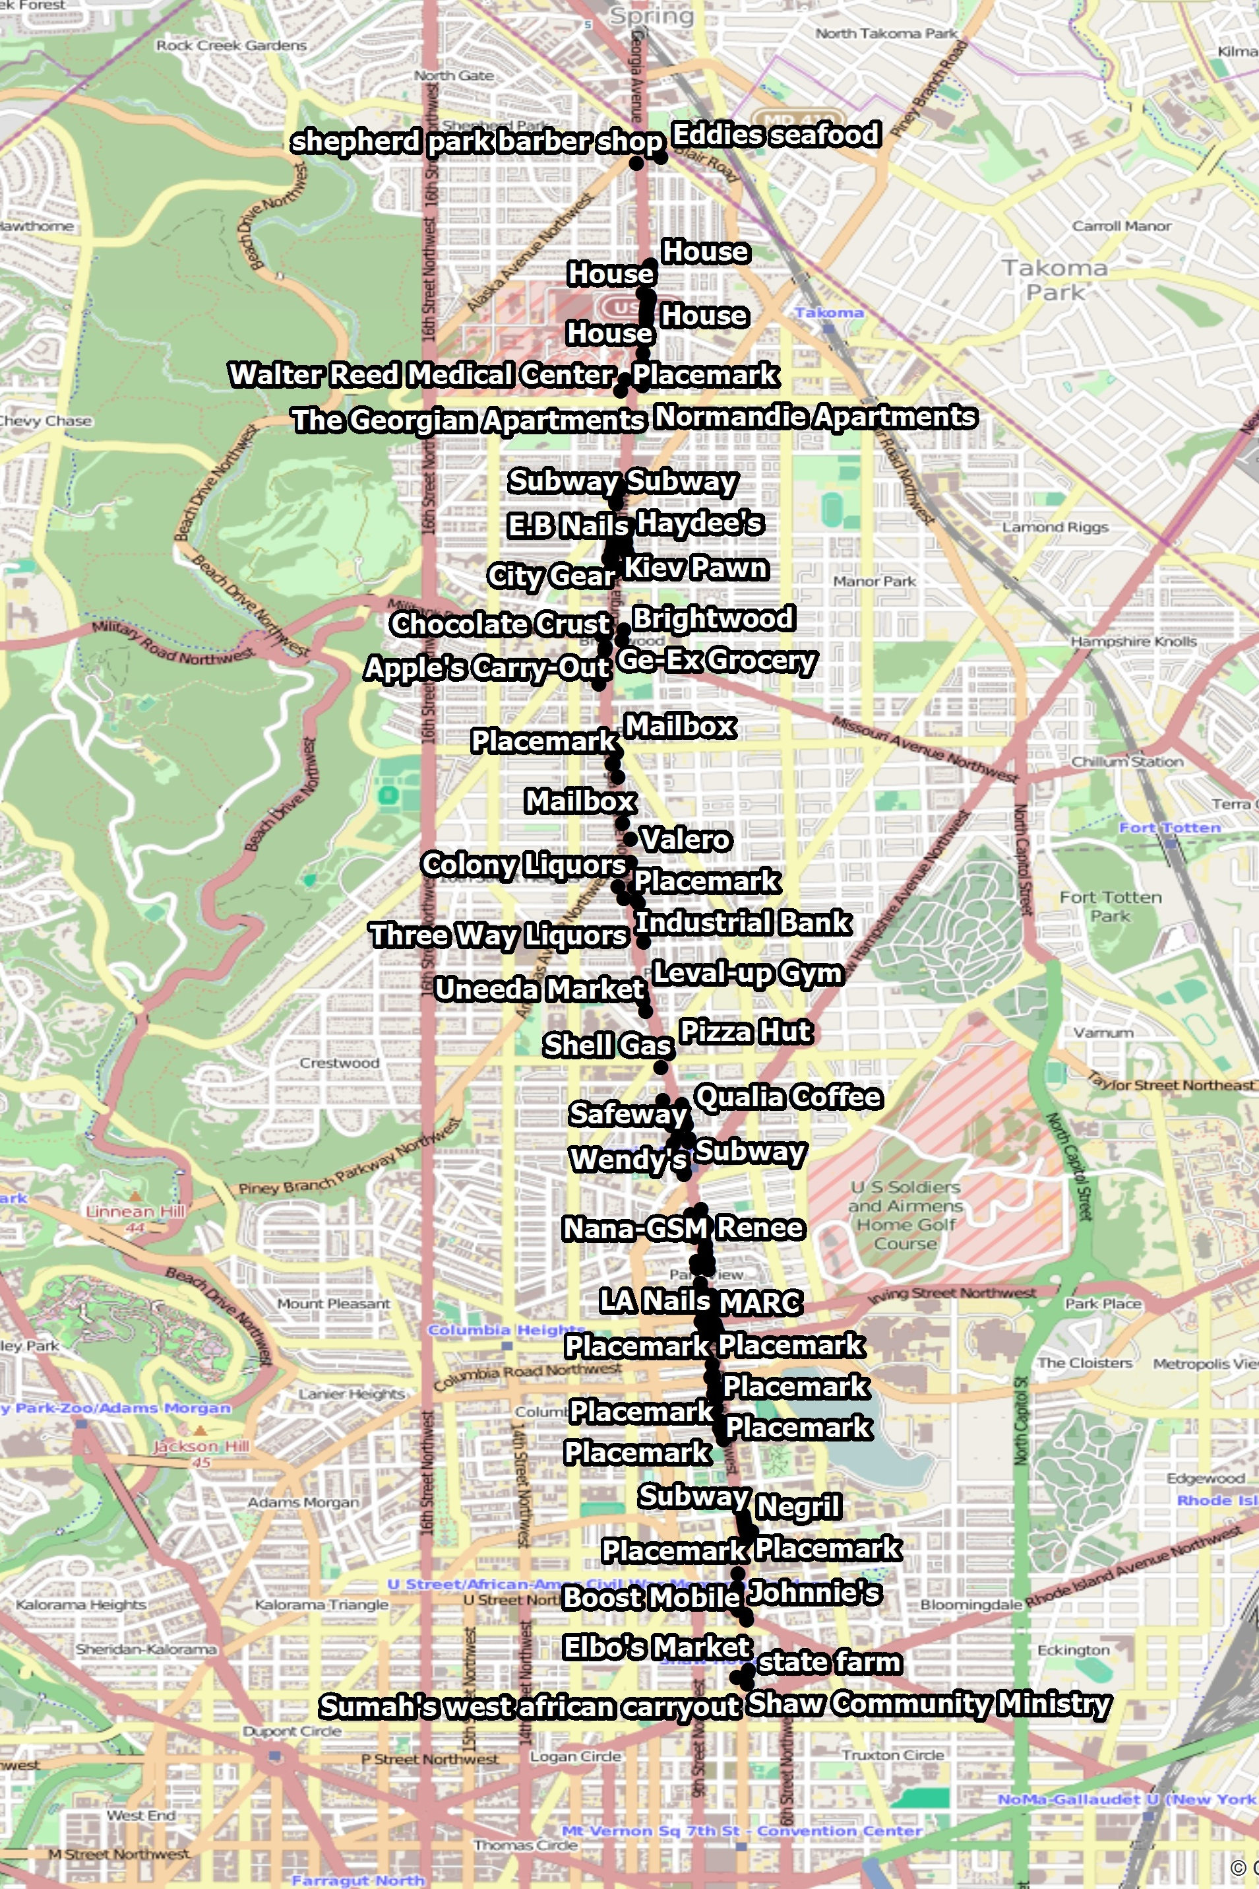
Georgia Avenue Mapping Project
Youth Ambassadors used Georgia Ave data gathered for street-level survey
We trained ~15 Youth Ambassadors in how to edit in OpenStreetMap
Results:
Over 270 features added to the OpenStreetMap
Survey data visible on the map!
http://wiki.openstreetmap.org/wiki/Georgia_Avenue_Youth_Ambassadors_Mapping_Project

Slide 13
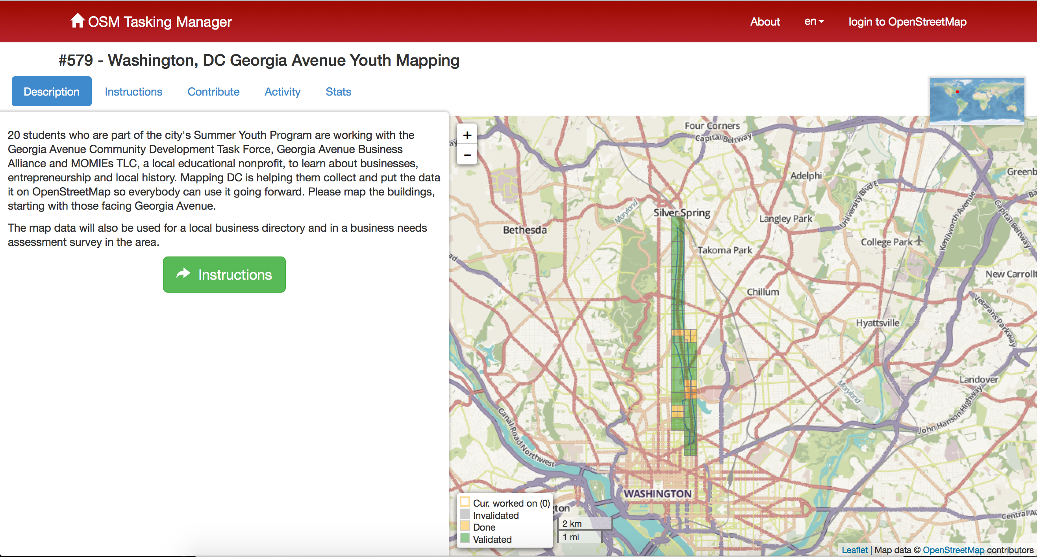
Using the OSM Tasking Manager to control workflow

Slide 14
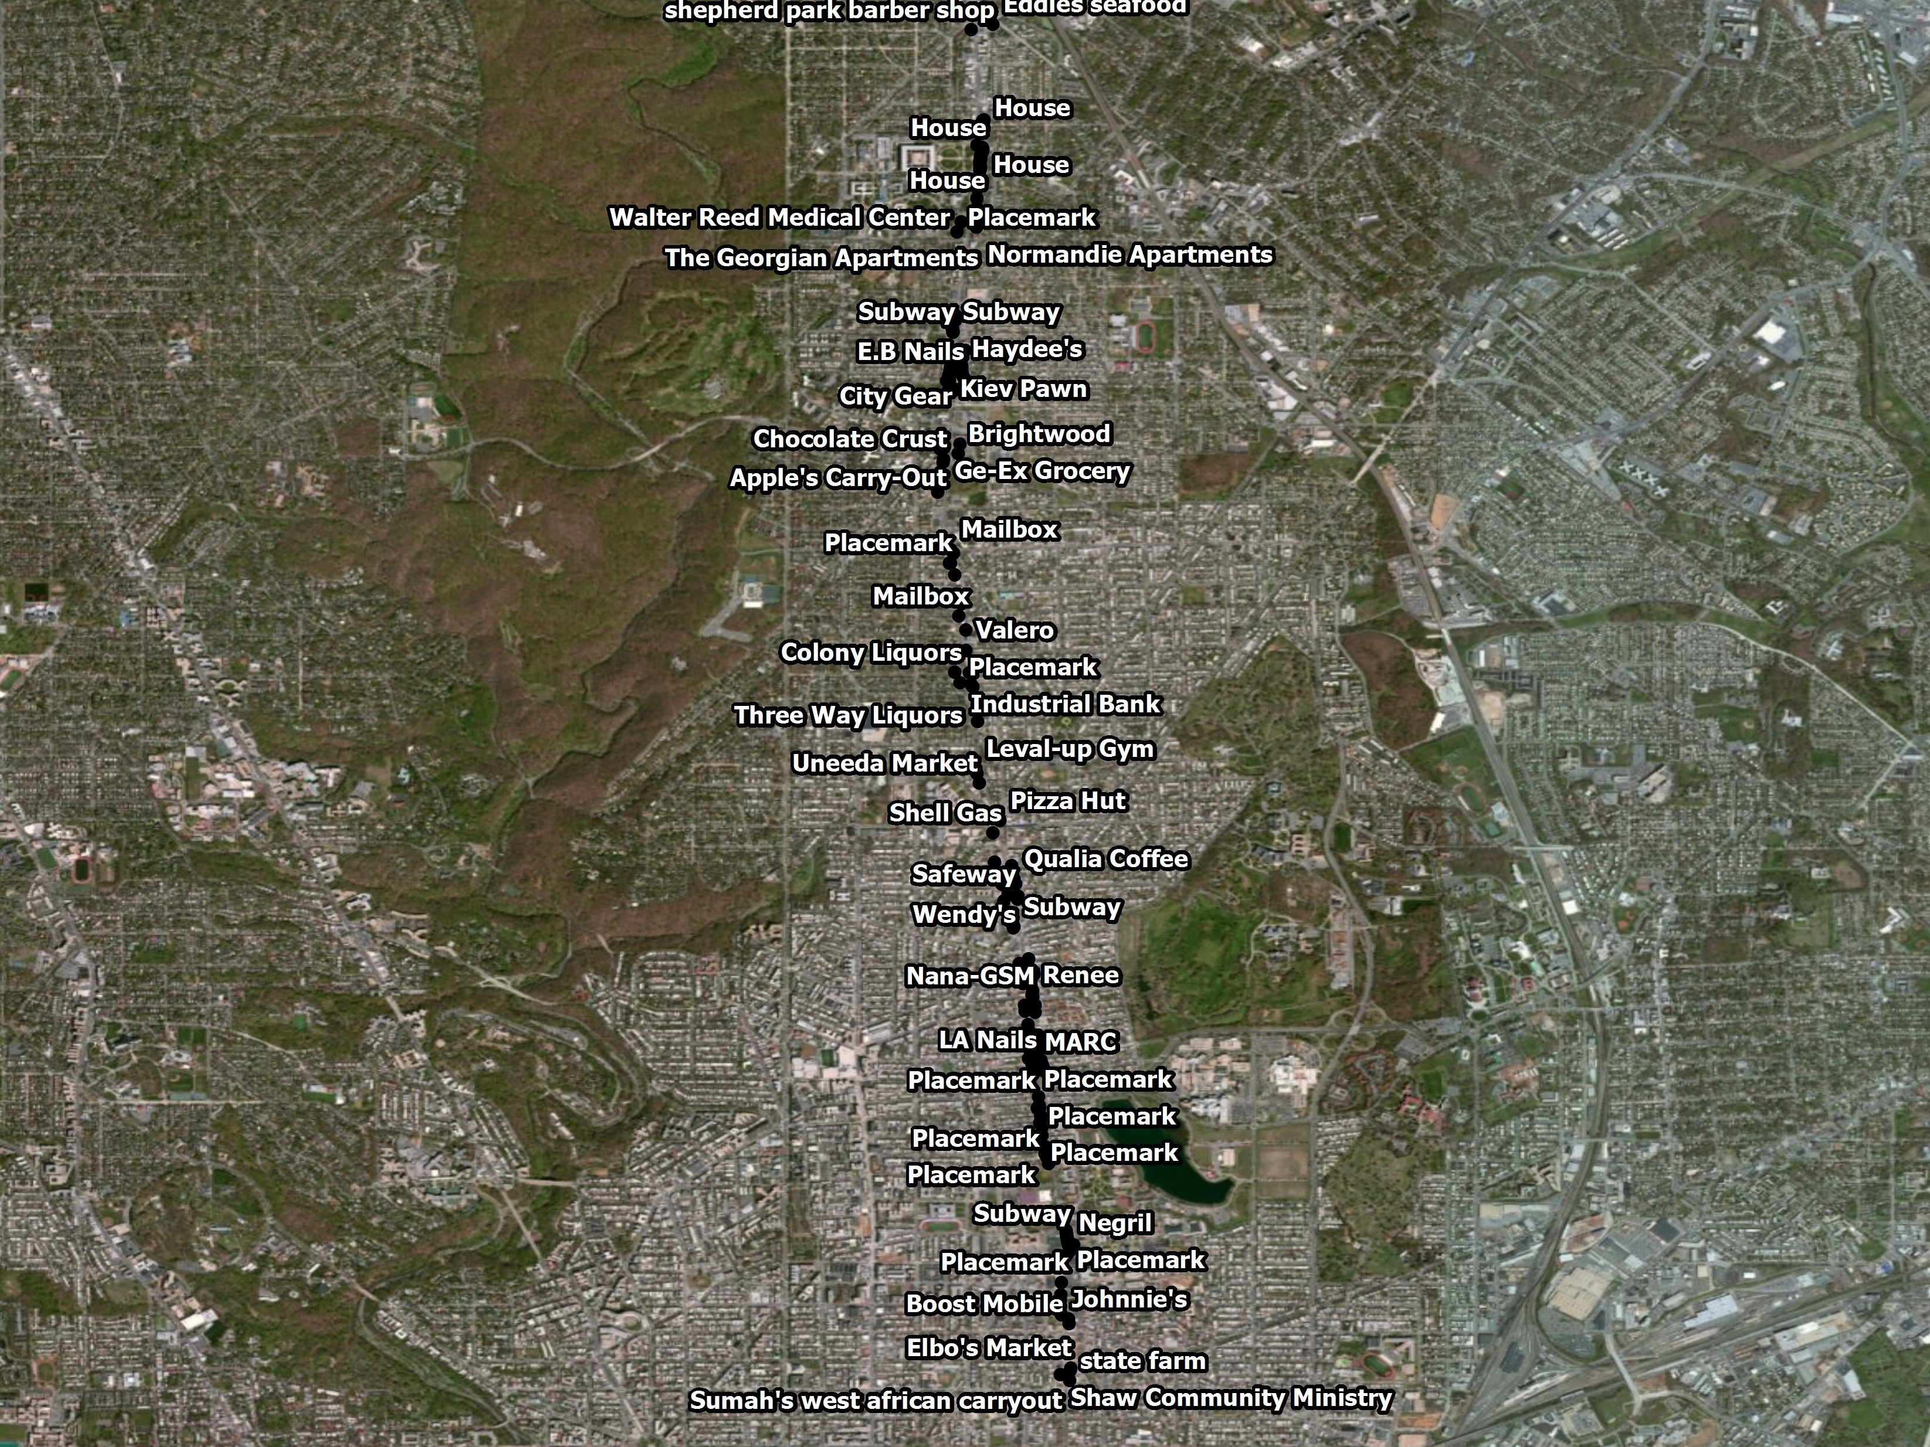

Slide 15
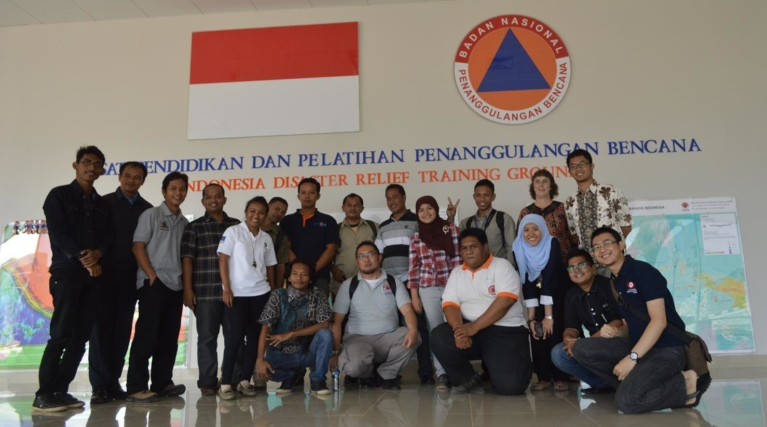
Highlight: HOT Indonesia
University Outreach Program

Slide 16
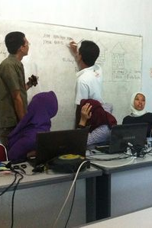
University Outreach & Contingency Planning
Focus is disaster preparedness and contingency planning for vulnerable areas
Working with local communities to identify & map exposure and risk
Using QGIS & InaSAFE plugin for downstream analysis
Over 4 years, conducted 86 trainings, 2300 people trained, ~2m buildings, ~14500 schools

Slide 17
Why TeachOSM?
Reasons to Use OpenStreetMap to Teach Geography

Slide 18
OpenStreetMap Gives Students Immediate Experience
Direct Learning - Young adults gain direct experience of space, place, and location
Geography at a 1:1 Scale
The terrain is the map
Nurture an understanding of how to read the landscape

Slide 19
OpenStreetMap Complements Social & Historical Learning
Provides contextual engagement that can broaden academic experience and vocational choices
History-shaping events often happen at certain places for geographic reasons.
Contributing to OSM, -through site surveys, editing, & mapping with others, helps us understand geographic processes that underpin social events.

Slide 20
OpenStreetMap Supports Collaborative Learning
By definition, a mapathon is a project based learning experience
Collaborate to map features of interest and significance
Share observations about your community
Give visibility to community landmarks
Establish autonomous communities of mapping expertise

Slide 21
OpenStreetMap Provides Opportunities for Service-based Learning
Opportunities to engage in ongoing community service projects & service learning engagements
Contribute to humanitarian relief efforts through Humanitarian OpenStreetMap Team
MapRoulette,’micro-tasking’ for data quality & effective for service learning
Give young adults a meaningful stake in maintaining map data

Slide 22
OpenStreetMap Supports Self-directed Learning
The open platform encourages self-guided learning and allows students to challenge themselves.
Mapping projects encourage collaboration & teamwork
Students learn how to think critically about geographic features and how to model their world.
Active mapping nurtures the young adult’s natural inquiries into the world.

Slide 23
OpenStreetMap Requires Fews Special Resources
No software required - works in the browser
No permission required - OSM is a do-acracy: DO IT!
Data are free and can be exported for downstream use in desktop GIS packages (e.g. QGIS, ArcGIS)
No fees, licensing charges, royalties, paywalls, subscriptions, etc.
Lower cost = greater accessibility

Slide 24
Sample Ideas for Projects
Conduct a street survey in your neighborhood:
http://teachosm.org/en/cases/DCGreatStreets_survey_casestudy/
Map for disaster relief/preparedness:
http://mapgive.state.gov and http://missingmaps.org/
Add historical features to OpenHistoricalMap:
http://ow.ly/MfhZw
Map local food resources:
http://teachosm.org/en/cases/farmers-market/
Start a student mapping society:
http://youthmappers.org/

Slide 25
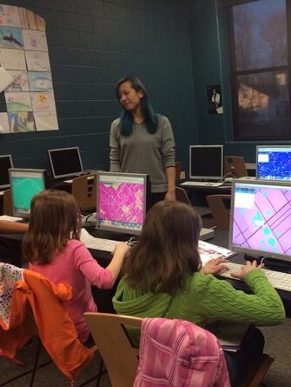
Getting Involved
Where do I get started?
Subscribe to the TeachOSM mailing list
Send an inquiry to info@teachosm.org
How do I contribute?
Draft a case study for the web site (http://teachosm.org)
Help refine our materials
Photo: middle-school school students learning to map.
Credit: MaptimeSF/Lyzi Diamond

Slide 26
Summary
TeachOSM promotes the use of OpenStreetMap as a platform for teaching geography
TeachOSM offers resources for geo-literacy, social engagement, service learning, and independent learning opportunities.
Reasons for using OpenStreetMap include hands-on learning, accessibility, and affordability.
Use TeachOSM and help us make it better

Slide 27



Thank You!
Steven Johnson
GeomanticLabs
sejohnson8@gmail.com
@geomantic
geomantic
The entirety of this document is licensed under Creative Commons CC-by-SA-2.0 share-alike license: https://creativecommons.org/licenses/by-sa/2.0/

